Slide 1

Hybrid Recommender System for Fashion Articles (DSAI Mini Project REPA)
Daniel Yang
Joel Lim
Rhys Lie

Slide 2
TABLE OF CONTENTS
01
02
03
Problem Definition
Exploratory Data Analysis
In-Depth Analysis
Problem Definition
Uncovering general trends
Finding insights from combining the datasets
04
05
06
Article Recommender
“Try Something New!”
Summary of Findings
Future Works
Filter trending items using customer preferences extracted from transaction history
Key insights that can be highlighted to the fashion retailer
Limitations and improvements to our current approach

Slide 3


PROBLEM DEFINTION
01

Slide 4

Background
The e-commerce market has experienced unprecedented growth in the last 5 years. The increasing significance of such a service in this digital age, have forced retailers to extract value from newly unlocked data points

Slide 5




PROBLEM STATEMENT
With the right analysis, the data can be used to better cater to customer preferences to combat declining sales, as well as more accurately predict inventory to minimize inventory costs.
But how should retailers, of any size, approach their data analysis effectively?

Slide 6
Our Solution
We answer the following question which is valuable to fashion retailers.
Which fashion articles will a particular customer be interested in purchasing next?
Customer ID
(Input)
List of Article IDs
(Output)
Key Considerations
1. Trending Market Purchases
2. Age Demographic Habits
3. Individual Historical Purchases
4. AI Recommendation
Notes:
The fashion industry is notably driven by trends and factors such as age demographics. We leverage key factors that give us a good range of relevant results to work with and scope it in further with individual customer preferences. On top of that, we use AI to recommend complementary articles.

Slide 7

Hybrid Recommender System
We carry out the filtering of our recommendations in a systematic manner
Collaborative Filtering
Trending Market Purchases
Age Demographic Habits
Top 100 Relevant Popular Purchases
Content Based Filtering
Individual Historical Purchases and Preferences
Most relevant few articles
DNN to suggest complementary items
Goal: List of recommended articles for the customer

Slide 8

EXPLORATORY DATA ANALYSIS
02

Slide 9
OUR DATASET
Articles
Transactions
Customers
Detailed information on articles 35MB
Information on customer transactions 1.24GB
Detailed information on customers 202MB
Our chosen dataset contains the following key details from a fashion retailer. The attributes sufficiently represents common data points that would typically be collected. Our dataset covers the time period of year 2020.

Slide 10
EDA APPROACH
Identify most relevant/useful data columns
Use the appropriate charts to visualize trends
Process and understand findings
Articles
Transactions
Customers
What type of articles are trending?
Fashion categories
Colours
Graphical appearances
Where are customers spending on and how much?
Transaction frequency
Average quantum
How can we best profile customers to learn their preferences?
Age

Slide 11



DATA WRANGLING METHODOLOGY
Conversion to more suitable data types
E.g., Pandas datetime
Fortunately, our dataset was relatively well populated and had almost no empty value that we had to drop or replace. Instead, we took a few other steps to make our subsequent data analysis more efficient
Selecting only necessary columns for queries
Using Log scale when necessary for better visualizations
E.g., df = transactiondata[[‘price’, ‘customer_id’]]
Notes:
- article_id : unique id of every article.
- product_code, prod_name : unique id of every product and its name.
- product_type_no, product_type_name : type of every product and its name
- graphical_appearance_no, graphical_appearance_name : graphical appearance of every product and its name
- colour_group_code, colour_group_name : color of every product and its name
- perceived_colour_value_id, perceived_colour_value_name, perceived_colour_master_id, perceived_colour_master_name : additional information on colours
- department_no, department_name : department of every product and its name
- index_code, index_name : index of every product and its name
- index_group_no, index_group_name : index group of product and its name
- section_no, section_name : section of product nad its name
- garment_group_no, garment_group_name : garment group of product and its name
- detail_desc: : additional information on product

Slide 12
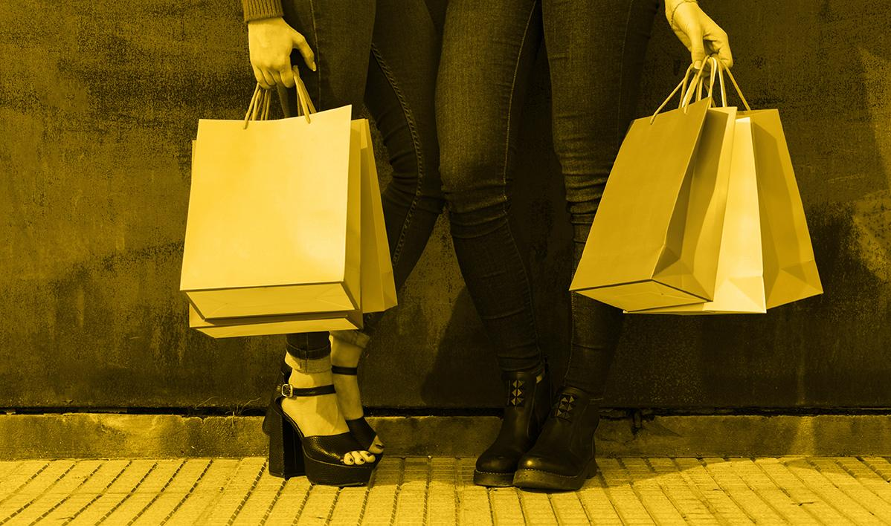
ARTICLES EDA

Slide 13
ARTICLES ATTRIBUTES
article_id
prod_name
prod_type_name
unique identifier of article
product name
product type name
graphical_appearance_name
colour_group_name
perceived_colour_value_name
graphical appearance of article
colour group of article
perceived colour of article
Notes:
- article_id : unique id of every article.
- product_code, prod_name : unique id of every product and its name.
- product_type_no, product_type_name : type of every product and its name
- graphical_appearance_no, graphical_appearance_name : graphical appearance of every product and its name
- colour_group_code, colour_group_name : color of every product and its name
- perceived_colour_value_id, perceived_colour_value_name, perceived_colour_master_id, perceived_colour_master_name : additional information on colours
- department_no, department_name : department of every product and its name
- index_code, index_name : index of every product and its name
- index_group_no, index_group_name : index group of product and its name
- section_no, section_name : section of product nad its name
- garment_group_no, garment_group_name : garment group of product and its name
- detail_desc: : additional information on product

Slide 14
ARTICLES ATTRIBUTES
perceived_colour_master_name
department_name
index_name
perceived master colour of article
department of article
index name of article
index_group_name
section_name
garment_group_name
index group name of article
section of article
garment group of article
Notes:
- article_id : unique id of every article.
- product_code, prod_name : unique id of every product and its name.
- product_type_no, product_type_name : type of every product and its name
- graphical_appearance_no, graphical_appearance_name : graphical appearance of every product and its name
- colour_group_code, colour_group_name : color of every product and its name
- perceived_colour_value_id, perceived_colour_value_name, perceived_colour_master_id, perceived_colour_master_name : additional information on colours
- department_no, department_name : department of every product and its name
- index_code, index_name : index of every product and its name
- index_group_no, index_group_name : index group of product and its name
- section_no, section_name : section of product nad its name
- garment_group_no, garment_group_name : garment group of product and its name
- detail_desc: : additional information on product

Slide 15
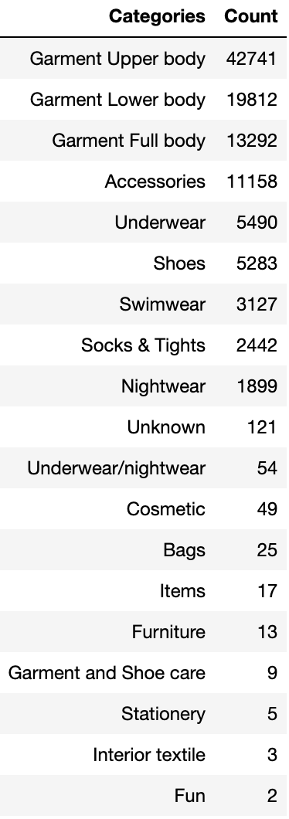
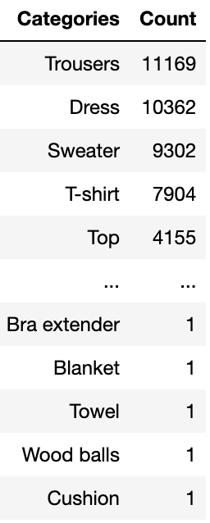
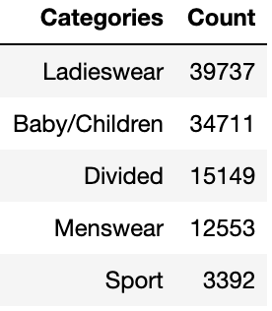
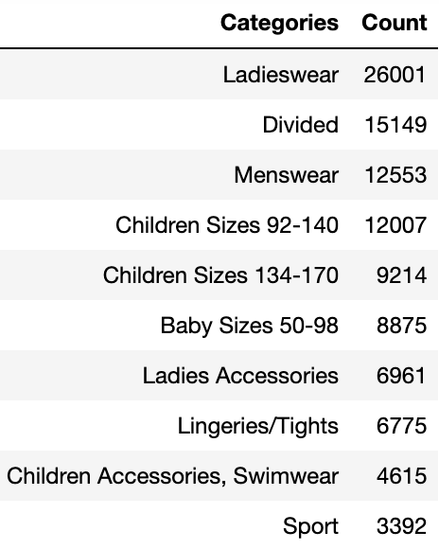
FIRST LOOK AT ARTICLES
index_group_name
(5 rows)
index_name
(10 rows)
product_type_name
(131 rows)
product_group_name
(19 rows)
Notes:
Based on the unique column names, we see the close relationship between index_group_name and index_name, as well as between product_group_name and product_type_name. However, we will be focusing on using index_group_name and product_group_name more in the future as it succinctly categorizes the articles into a reasonable range of categories that we can work with.

Slide 16
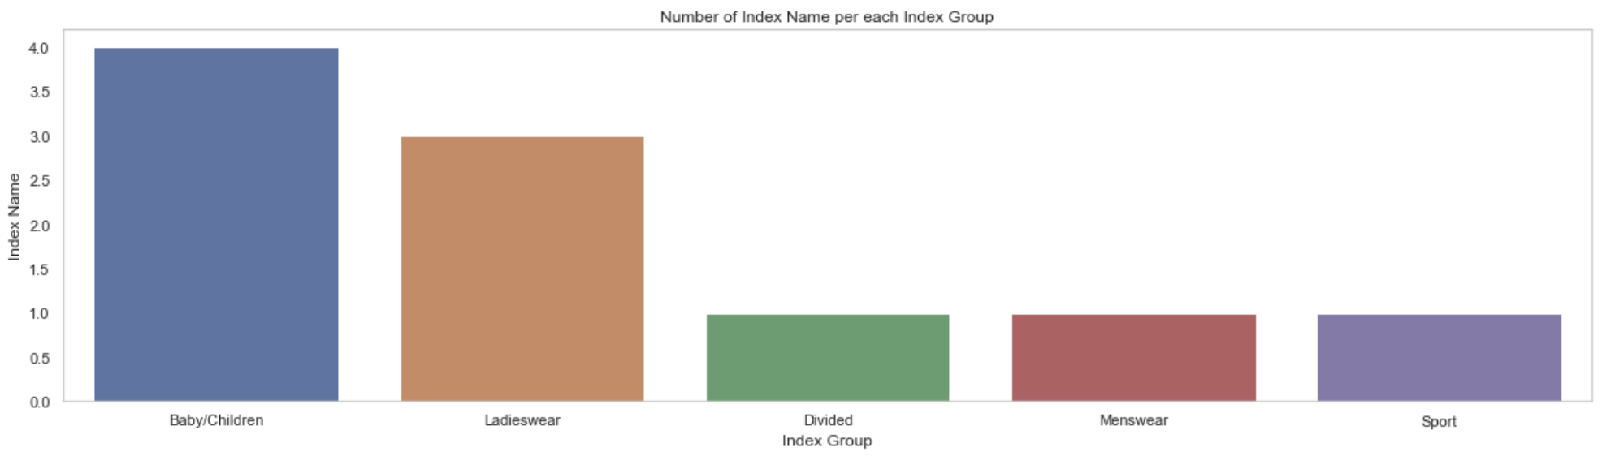
OBVIOUS CHOICE OF PREFERRED INDEX GROUPS
Now, we have a better idea on the index group of articles in this fashion retailer.
We see that their articles cater more for baby/ children and ladies, with sports attire having the least number of articles
Notes:
Most clothing pieces per Index Group - (Baby/children the most popular article category, followed by Ladieswear)

Slide 17
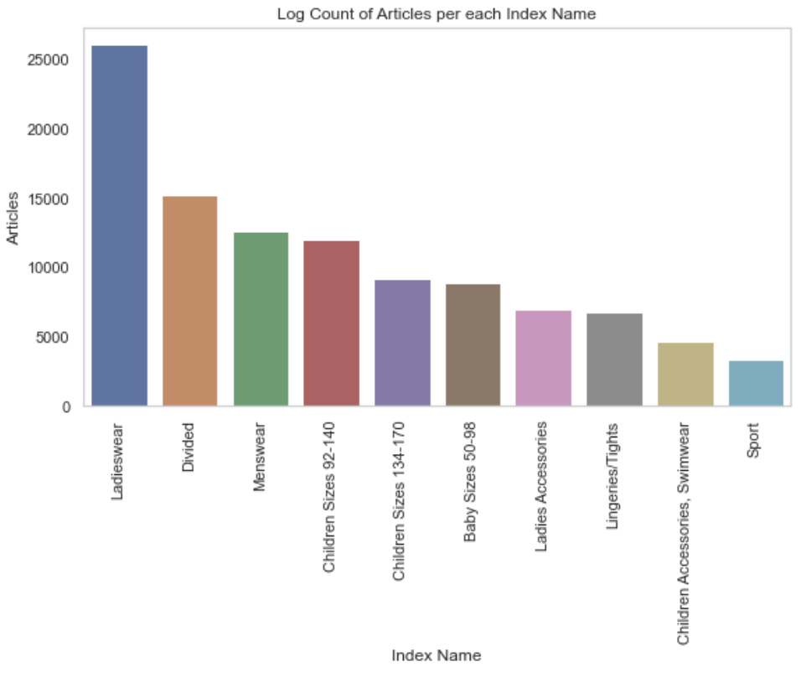
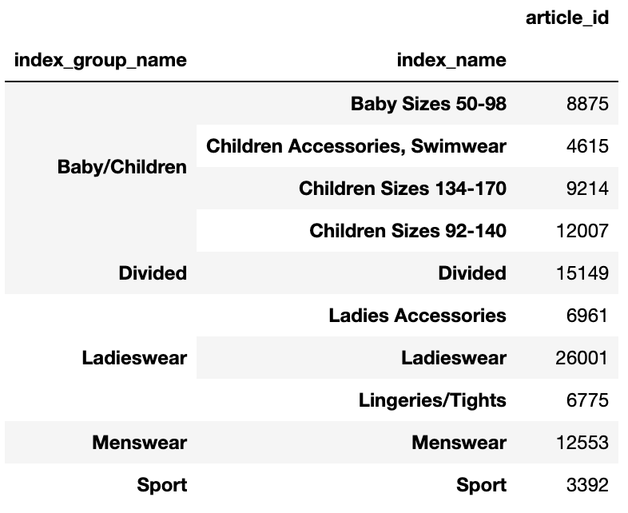
DELVING INTO INDEXES
Delving deeper into the indexes, we can see that the baby/children index group is split into various indexes catering to babies, children of different sizes, and one for accessories and swimwear.
Similarly, Ladieswear is split into 3 indexes, one for accessories, one for ladieswear and one for lingeries/ tights.

Slide 18
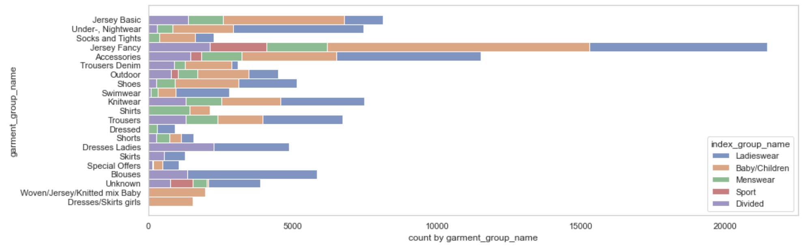
MORE ON GARMENT GROUPS
The garment group is also another interesting attribute to look at. We see that garment group defines the type of clothing the article refers to, and could span multiple categories. ‘Jersey Fancy’ and ‘Accessories’ are categories with the most unique articles. Some garment groups cater to specific index groups only (such as the baby/ girls articles).

Slide 19
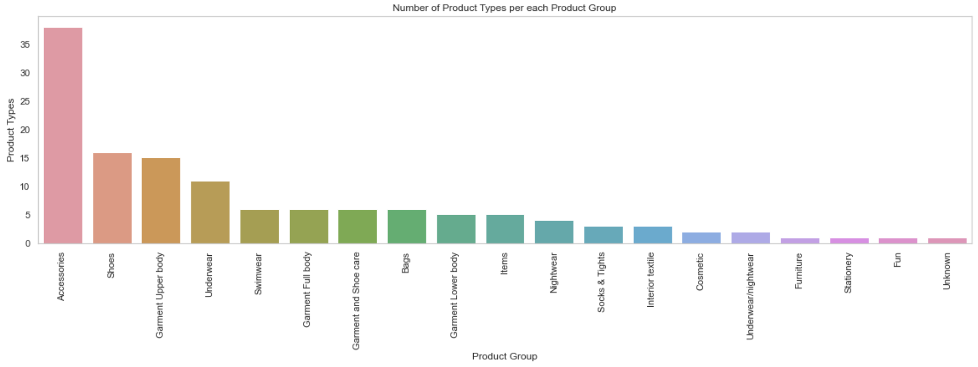
PRODUCT TYPES WITHIN PRODUCT GROUPS
We see that within the product groups, accessories has the most number of unique product types.

Slide 20
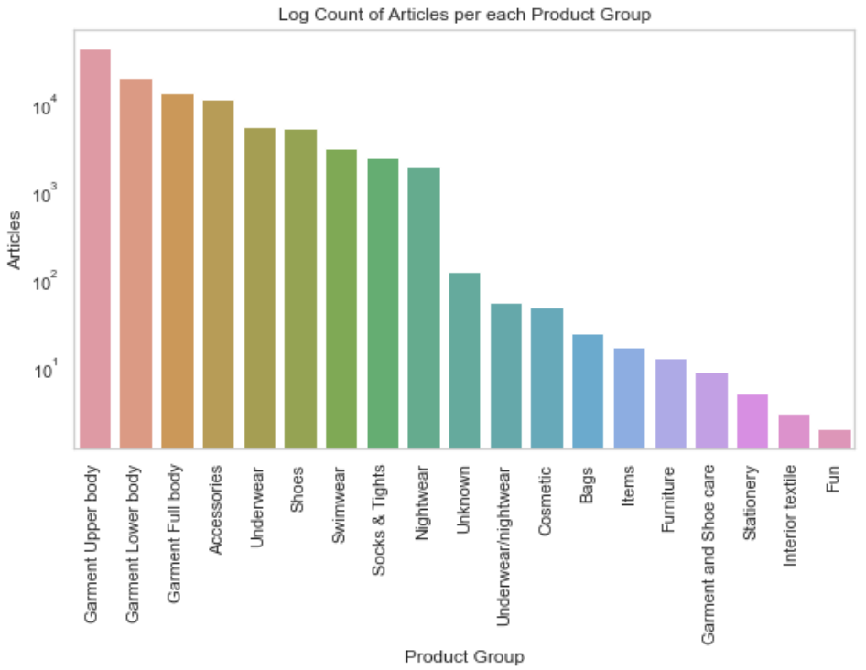
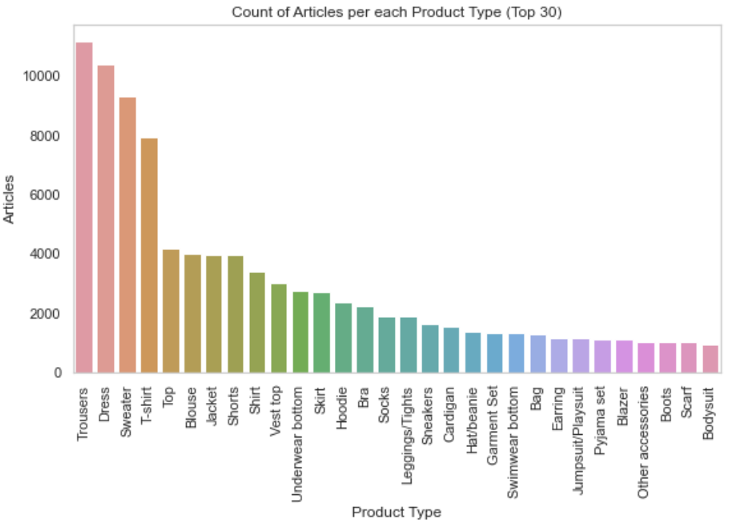
COUNT OF ARTICLES PER PRODUCT GROUP/ TYPE
As for product groups, garments has the most number of unique articles.
In terms of product types, we see that trousers, dresses and sweaters make up the top 3 in terms of counts of articles for each product type.

Slide 21
TRANSACTIONS EDA

Slide 22
TRANSACTIONS ATTRIBUTES
t_dat
customer_id
article_id
transaction date of purchases
unique identifier of customer (foreign key)
unique identifier of article (foreign key)
price
sales_channel_id
price of purchases
1 or 2 (channel in which purchases are made)
Notes:
### Transactions Data Description
- t_dat: transaction date
- customer_id (foreign key): unique id of customer
- article_id (foreign key): unique id of article
- price: price of purchase
- sales_channel_id: 1 or 2 (assume 1 is online, 2 is physical shops)

Slide 23
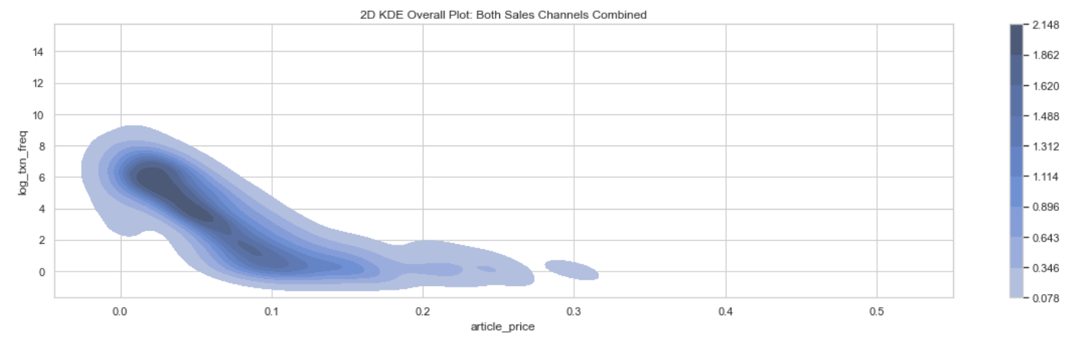
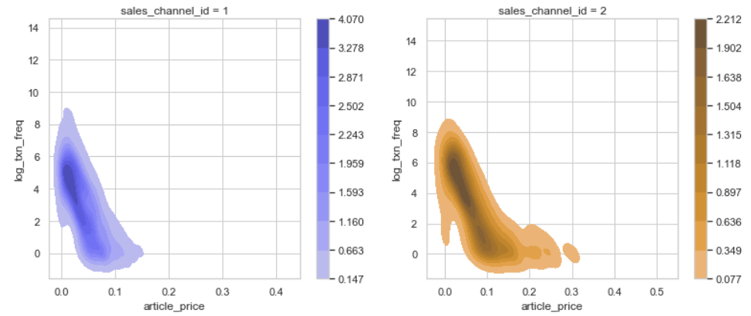
PRICE SPREAD OF ALL TRANSACTIONS
Using a 2D Kernel Density Estimation plot, we can clearly see the spread of prices for all the transactions. We observe that most transactions have a price quantum of about 0.02-0.03. This applies for both sales channels
Notes:
Analyzing trends on historical article prices in transactions made
Price range of all transactions
Mean customer spending over time
Mean price of Article in index_group over time
Price variation of Articles in product_groups

Slide 24
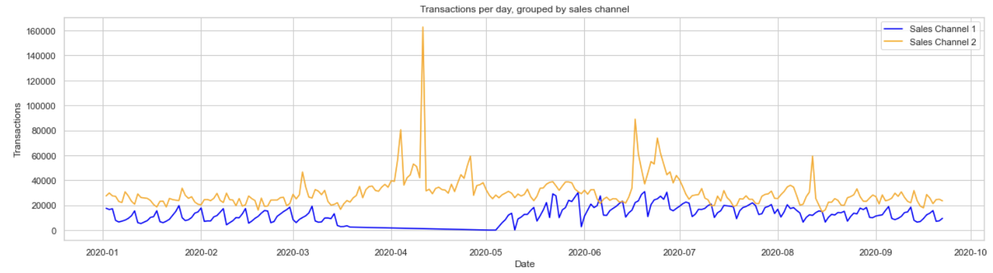
DISTRIBUTION OF TRANSACTIONS OVER TIME
Looking at the overall trend of number of transactions over time, we see a cyclically trend that increases and decreases almost consistently across each month. This will allow us to estimate the number of transactions that will likely take place given a specific time period. At the same time, we see a spike in transaction in Sales Channel 2 from March to May, while there was a steep decline for Sales Channel 1. We can deduce that Sales Channel 1 could be an online channel that went offline for that period for maintenance etc.

Slide 25
CUSTOMERS EDA

Slide 26
CUSTOMER ATTRIBUTES
customer_id
fashion_news_frequency
Active
unique identifier of customer
frequency that H&M sends fashion news to customers
0 or 1
club_member_status
FN
age
membership status of customer
0 or 1
postal code
age of customer
postal code of customer
Notes:
- customer_id : unique id of every customer
- FN : 1 or missed
- Active : 1 or missed
- club_member_status : Status in club
- fashion_news_frequency : How often H&M sends news to customer
- age
- postal_code : Postal code of customer

Slide 27
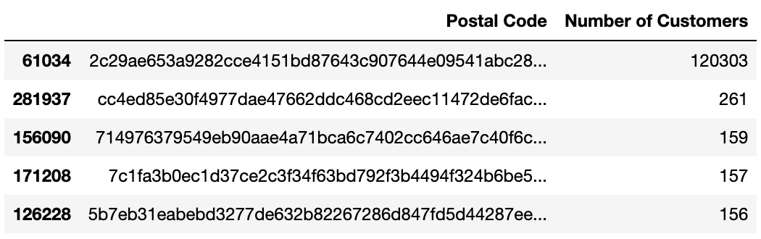
POSTAL CODE
Here we have abnormally large number of customers by one postal code Postal Code starting with "2c29ae653a9282cce4151bd87643c907644e09541abc28..." has 120303 customers, it could be the address of a huge distribution center, or secondary retailer.

Slide 28
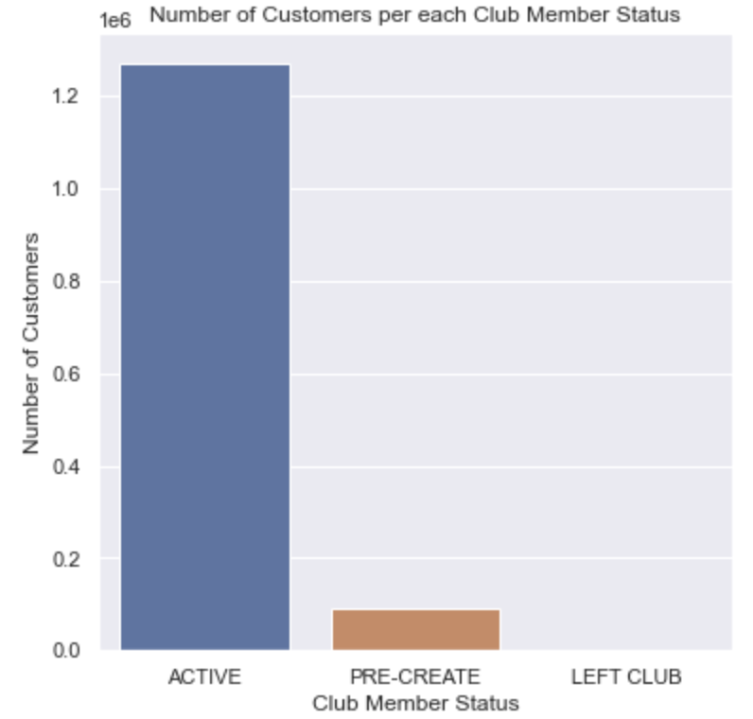
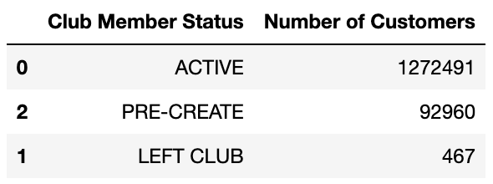
CLUB MEMBER STATUS
Status of the H&M Club. Most of the customers are active members of the club, with a small proportion are in the pre-creation status. A very small minority have left the club

Slide 29
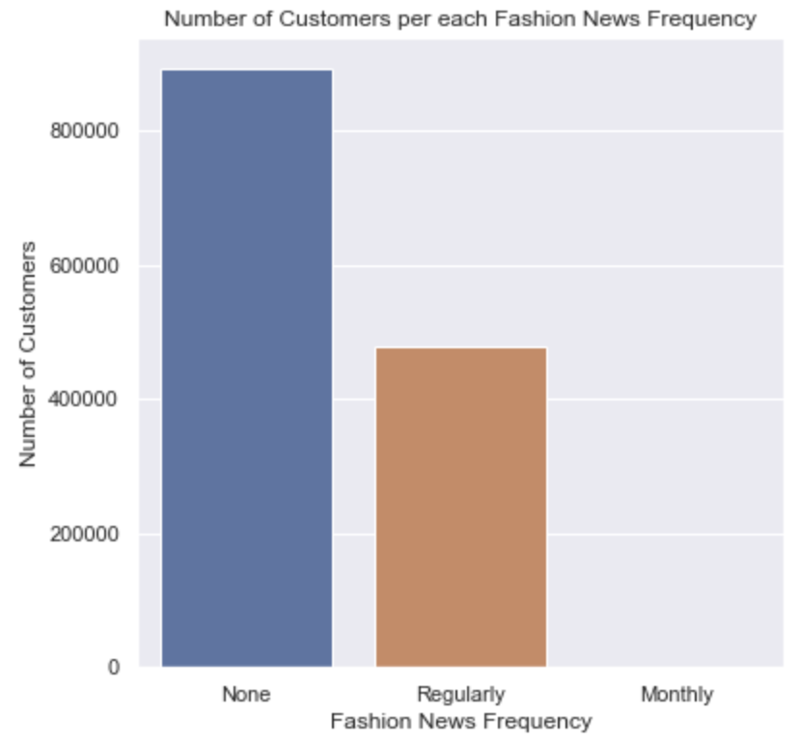
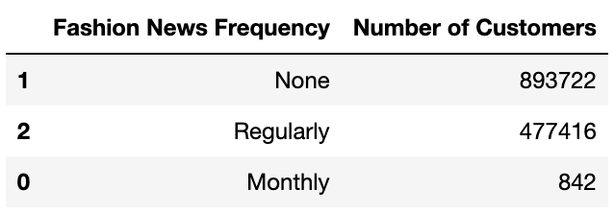
FASHION NEWS FREQUENCY
We see that most customers do not fancy fashion news, only an extremely small proportion want monthly fashion news, with many abstaining from it.

Slide 30
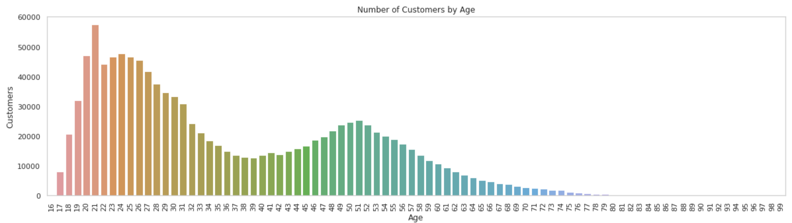
CUSTOMER DISTRIBUTION BY AGE
We see that the number of customers peak at early 20s and 50s.

Slide 31

IN-DEPTH ANALYSIS
03
Notes:
combinedEDA

Slide 32
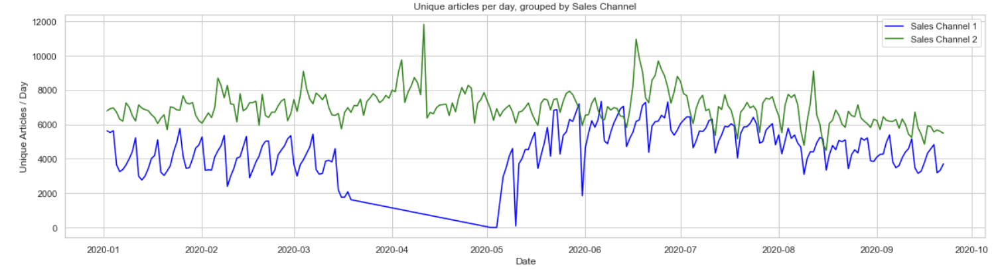
ANALYZING TRANSACTIONS AND ARTICLES
Unique Transactions over time
We observe a similar trend between the number of unique articles sold and transactions that take place over time. Generally, it makes sense and tells us that the transactions were of a diverse range of articles rather than a select few extremely popular items.
Unique Articles sold over time

Slide 33
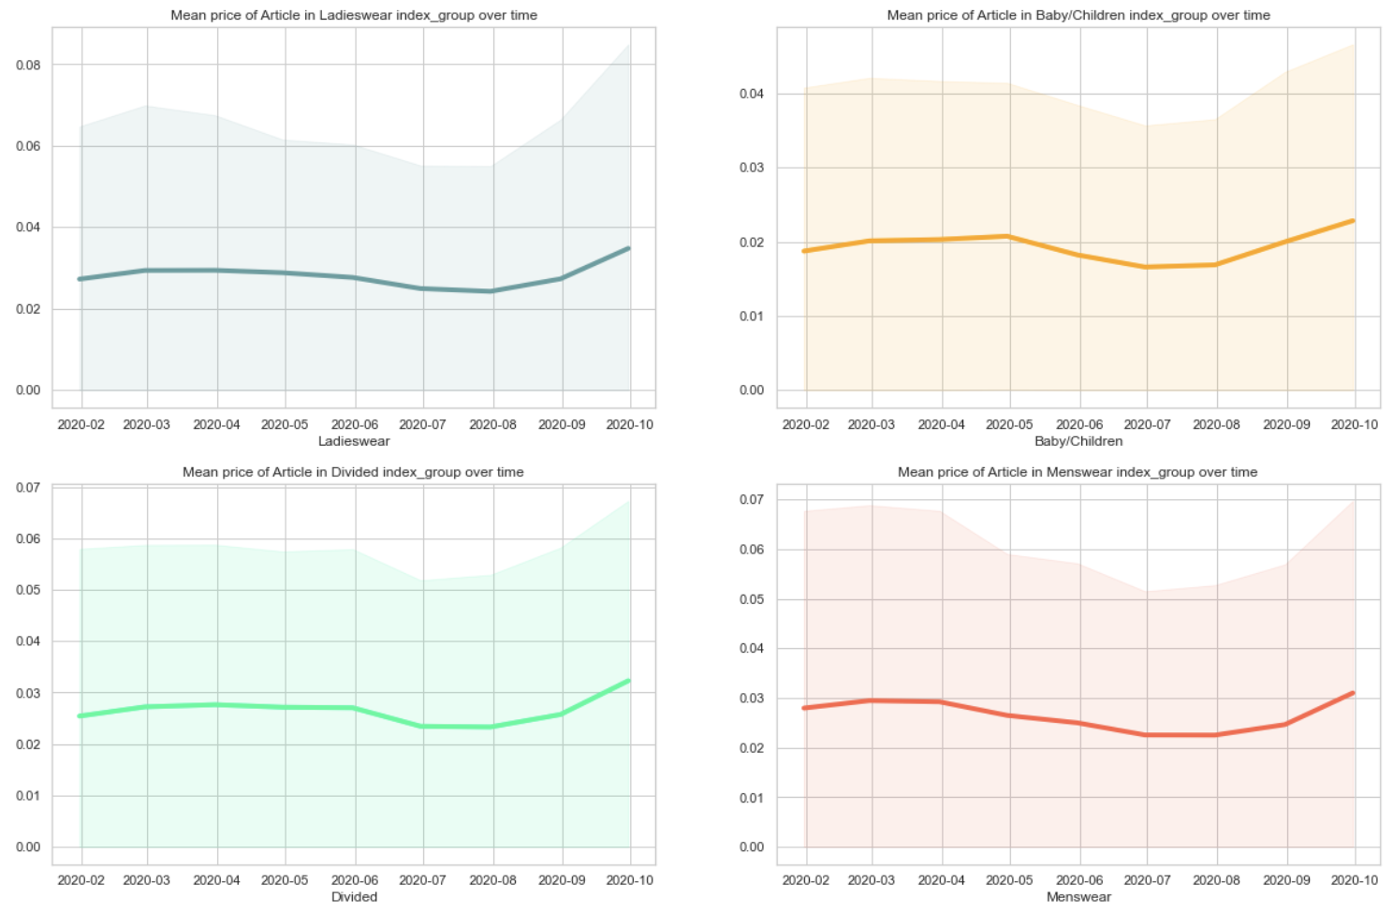
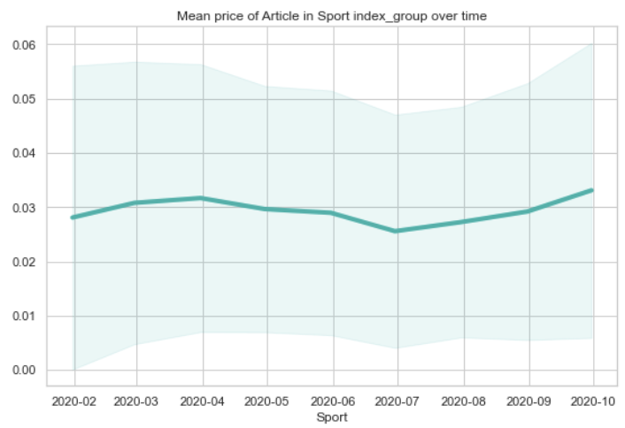
PRICE DISTRIBUTION OF ARTICLES
We observe that the average price of most articles, categorized by index_group moved in synch. Their prices did not fluctuate much apart from a dip in July of 2020 before trending back up. This rather stable prices throughout the year is expected and will also allow us to make proper estimations about future articles prices.

Slide 34
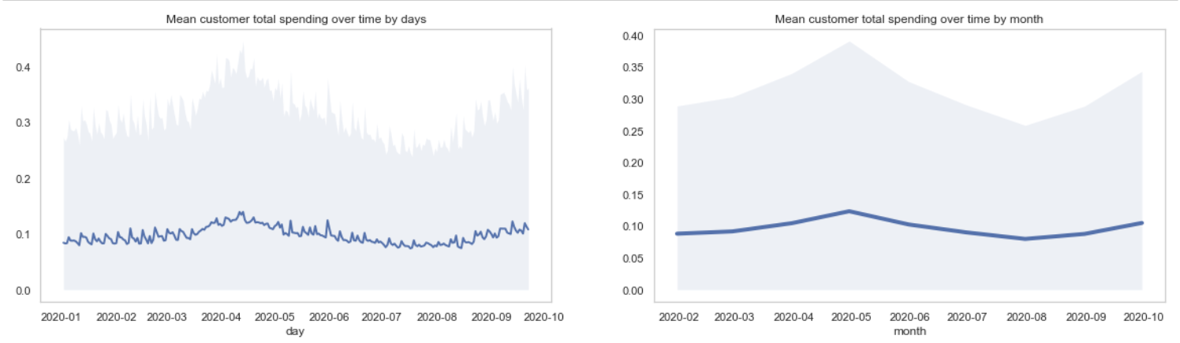
DISTRIBUTION OF CUSTOMER SPENDING OVER TIME
Filtered by Day
We see that customer spending stayed approximately constant throughout the year. It increased corresponding to the spike in unique transactions and decreased corresponding to the dip in article price as seen earlier. We were managed to link these observations to form a more cohesive picture of how the business of the fashion retailer is doing.
Filtered by Month

Slide 35
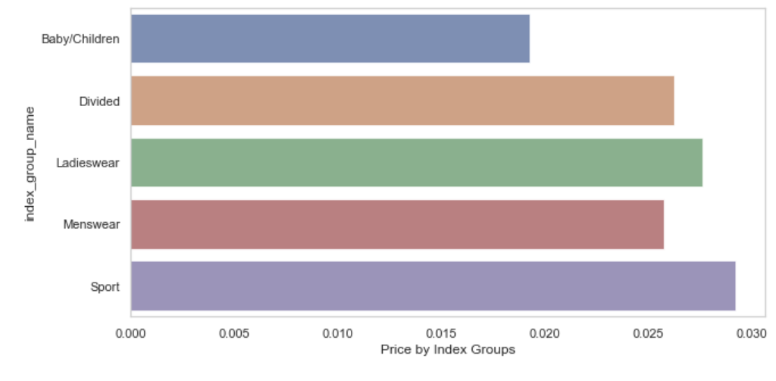
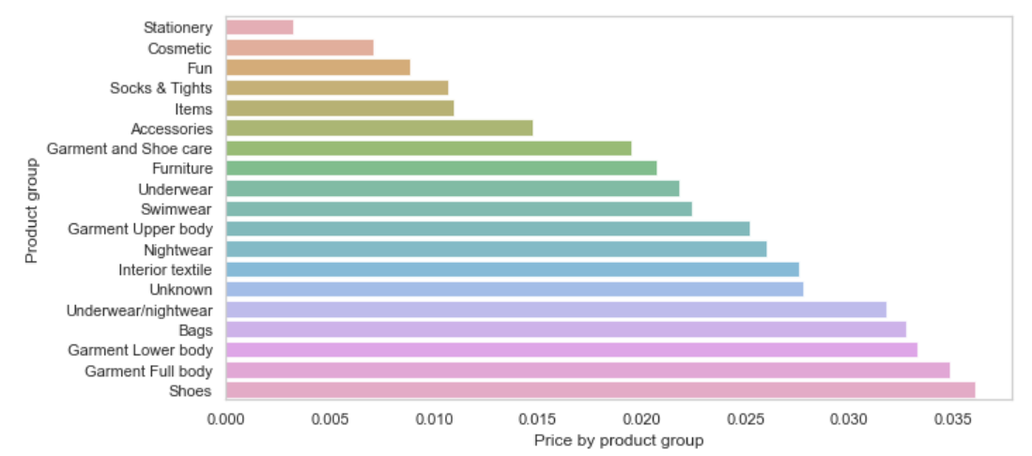
MEAN PRICE ACROSS INDEX AND PRODUCT GROUPS
We observe that sport and shoes products are slightly pricier.

Slide 36
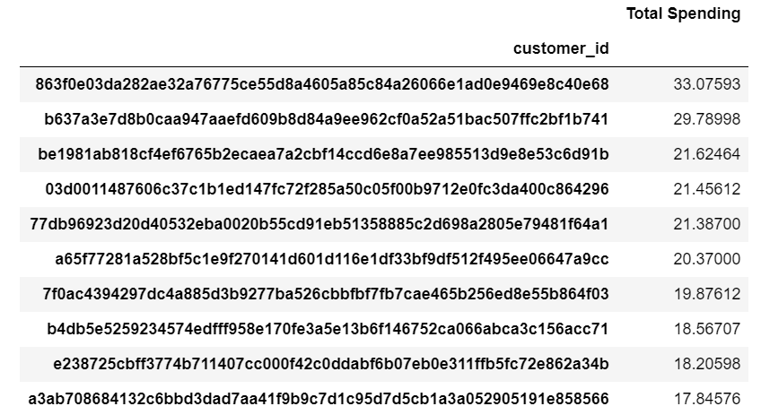
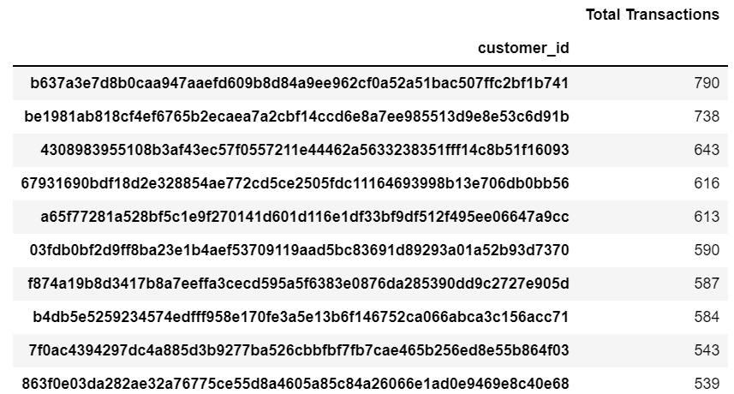
IDENTIFYING TOP PAYING AND TRANSACTING CUSTOMERS
We see that there are a few customers which appear as the greatest number of total transactions as well as total spending. The lack of overlaps signify customers who may have fewer transactions but of a higher quantum!

Slide 37
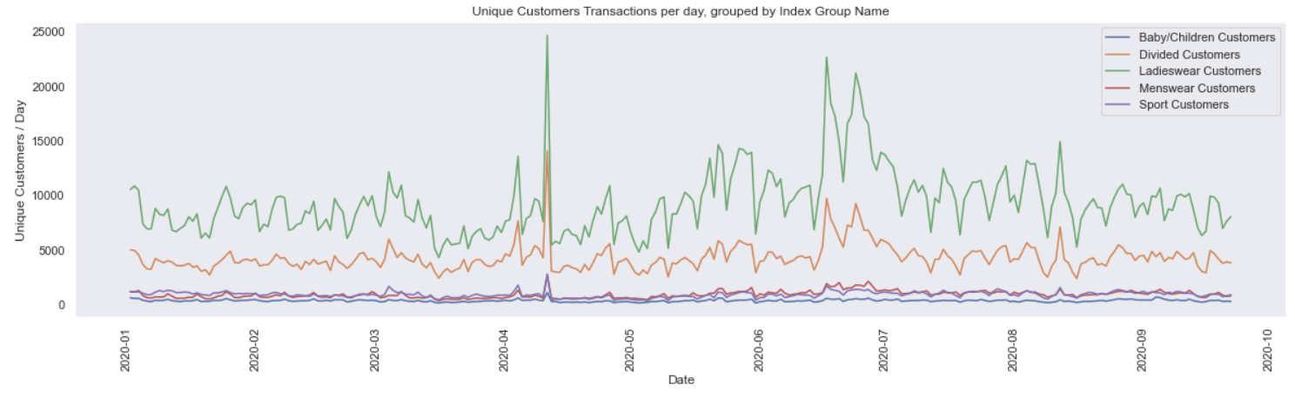
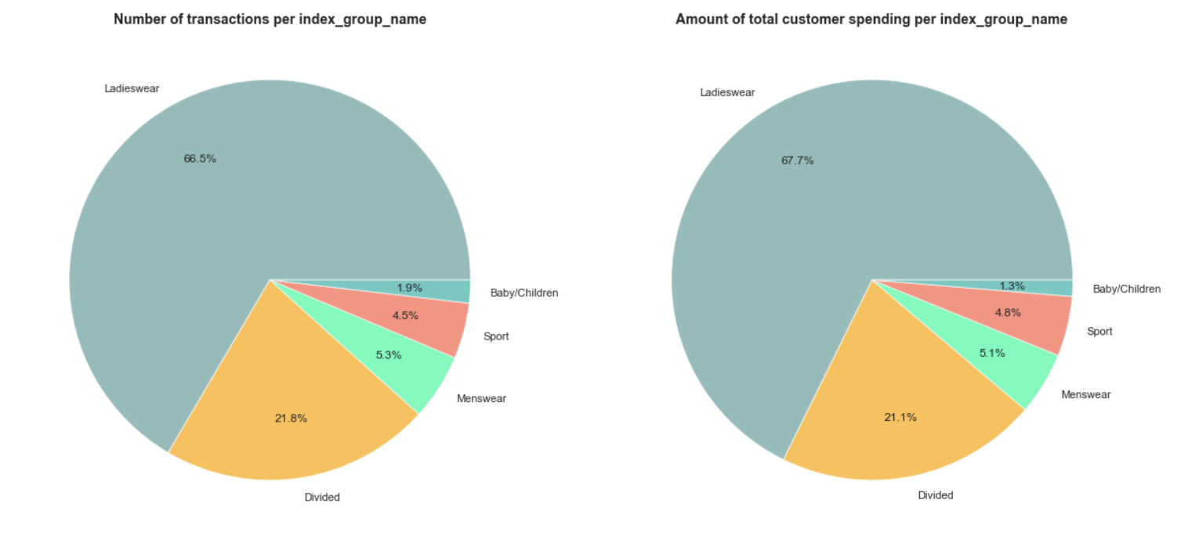
DISTRIBUTION OF UNIQUE TRANSACTIONS BY INDEX GROUP
We see that ladieswear takes up the bulk of transactions, in terms of quantity and spending. This is followed by divided, which targets teens.

Slide 38
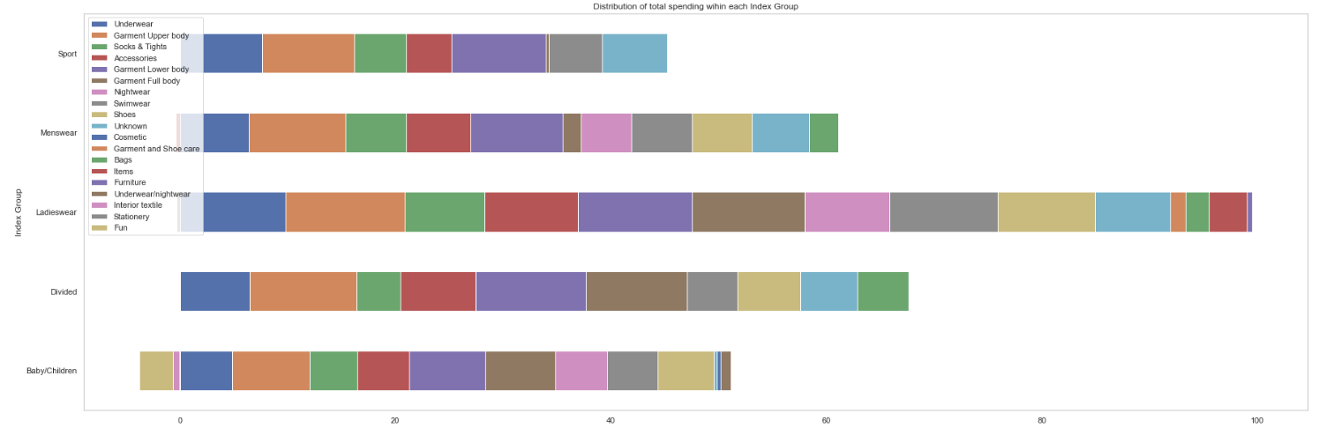
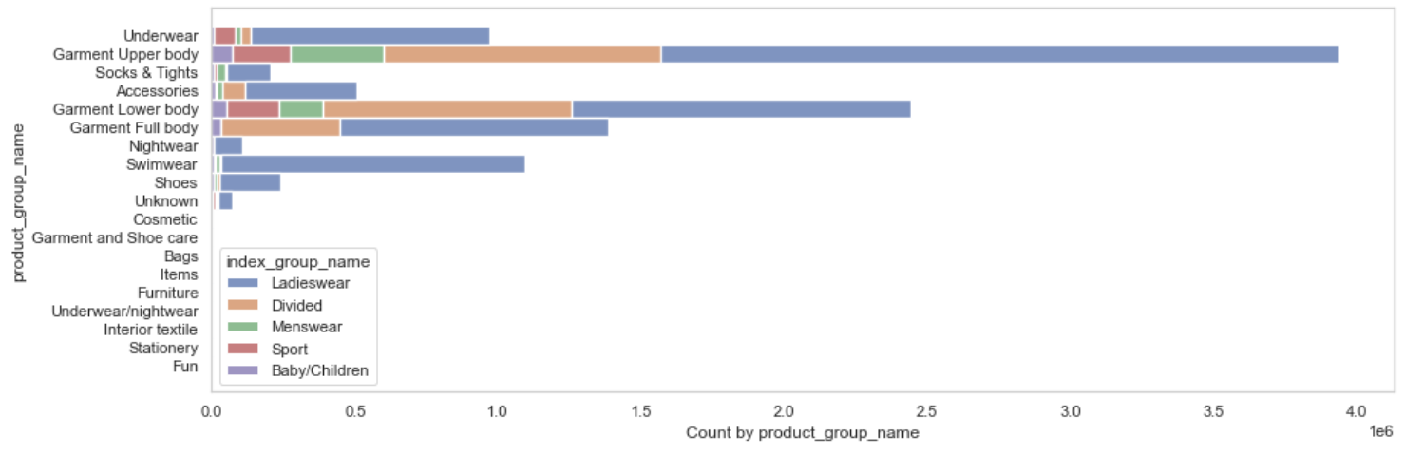
DIVING DEEPER INTO PRODUCT GROUPS
We see that ladieswear garment upper body, full body and underwear takes up a huge portion of spending and product quantity.

Slide 39

HYBRID RECOMMENDER SYSTEM – “TRY SOMETHING NEW!”
04
Notes:
fullWorkflow

Slide 40



OUR PROCESS
Step 1
Step 2
Step 3
General Idea
General Idea
General Idea
Find out what’s trending and likely to attract the customer
Limit the results based on the customer’s personal preferences
Expand the result set with other complementary articles that might be unexpected but will also interest the customer

Slide 41
OUR PROCESS
Step 1
Step 2
Step 3
Top 100 most popular articles by customer age group
*We assume that the customer will likely be interested in the mass fashion trend for his/her demographic at that time. We also do not scope down the customer’s gender as we do not have sufficient information and analysing transactions itself could be misleading
Choosing the most important and popular attributes based on the customer's transactions within past 3 months
*We assume that his past purchases are indicative of his preferences for his future purchases
Use Image Processing to recommend similar articles for customer

Slide 42
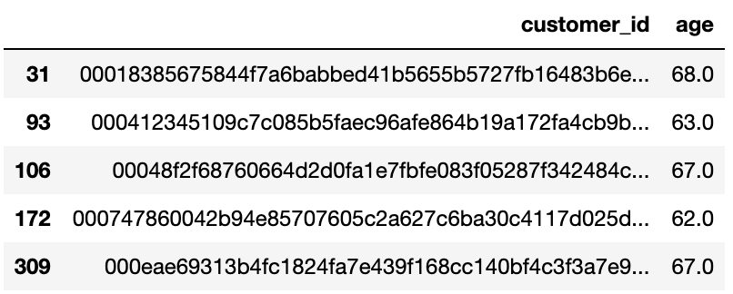
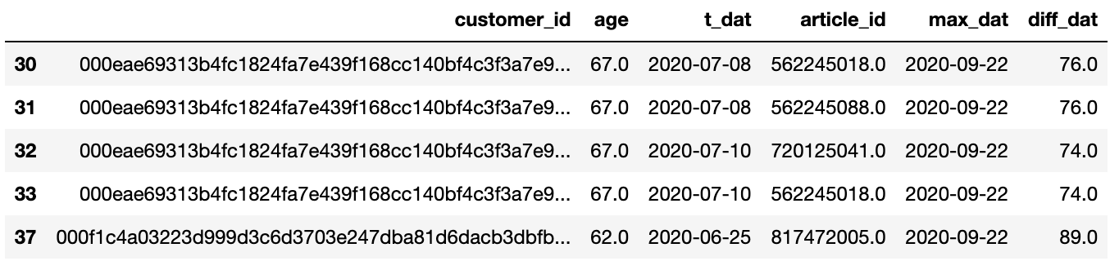
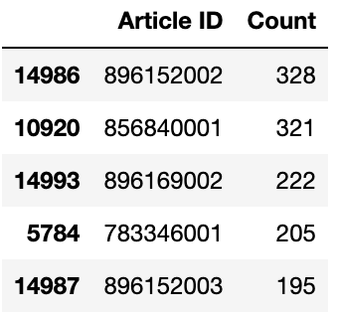
STEP 1
Get CustomerDF within required age range (e.g. 60-70)
Merge CustomerDF with TransactionDF on customer_id and find transactions within recent 90 days
Find top 100 articles from mergedDF based on purchase count for all customers within required age range

Slide 43
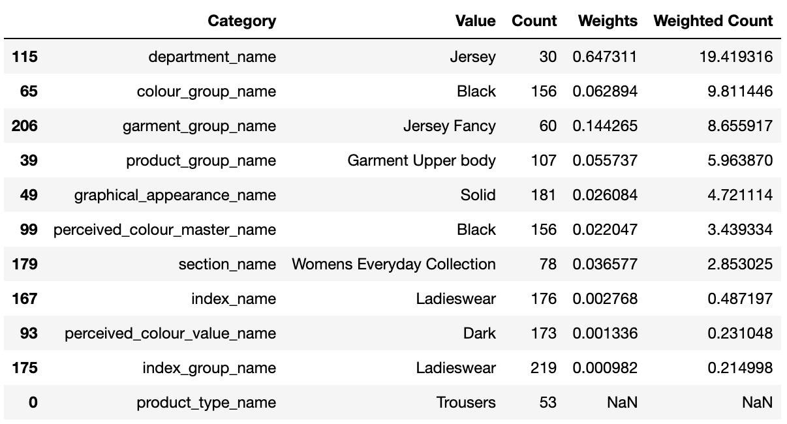
STEP 2
Get top attributes of articles bought by a specific customer within the past 3 months
Apply feature importance (Chi Squared coefficient) as weights to the absolute counts for each category
Updated feature ranking of each customer with new weights

Slide 44
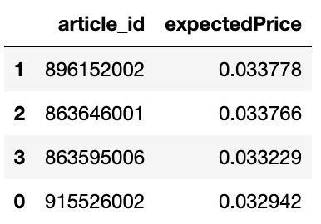
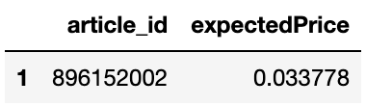
STEP 2
Combine Steps 1 and 2 to select Articles that are the top 100 in customer age group and possess the most characteristics of popular articles
Use Linear Regression to find find expected Price of Selected Articles
Find Mean Price of Transactions made by specific customer
Find article with mean price closest to expected price
Mean Price = 0.033971

Slide 45
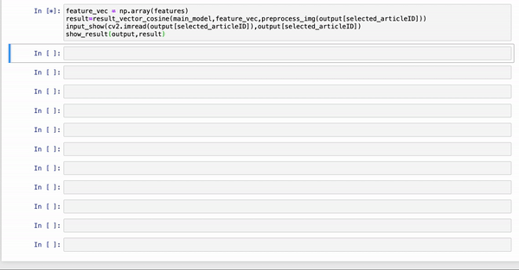
STEP 3
Suggest additional recommendations from previously trained feature map

Slide 46
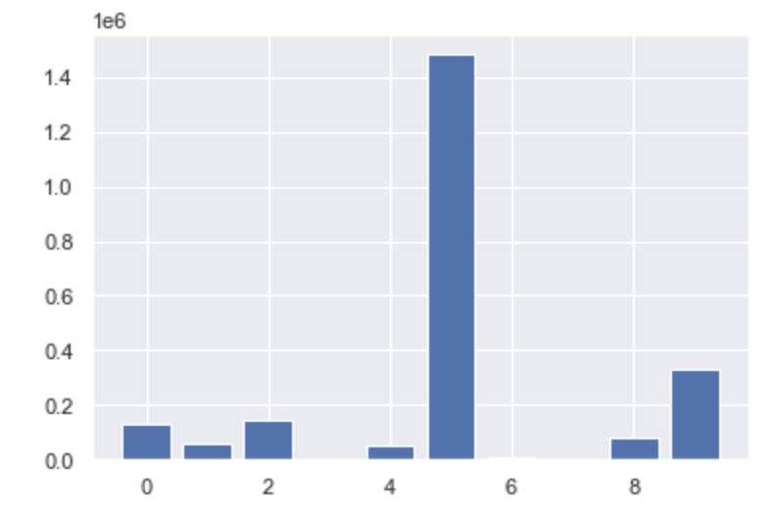
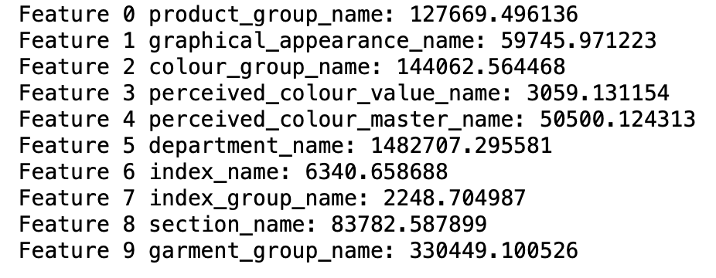
CHI SQUARED FEATURE SELECTION
Step 1
Step 2
Step 3
Obtain feature coefficients
Encode categorical attributes of clothes
Perform Train-Test Split (33% test size)
Pearson’s chi-squared statistical feature election strategy was used to select k most relevant features (Largest values)
Apply OrdinalEncoder on all transactions within an age group range

Slide 47

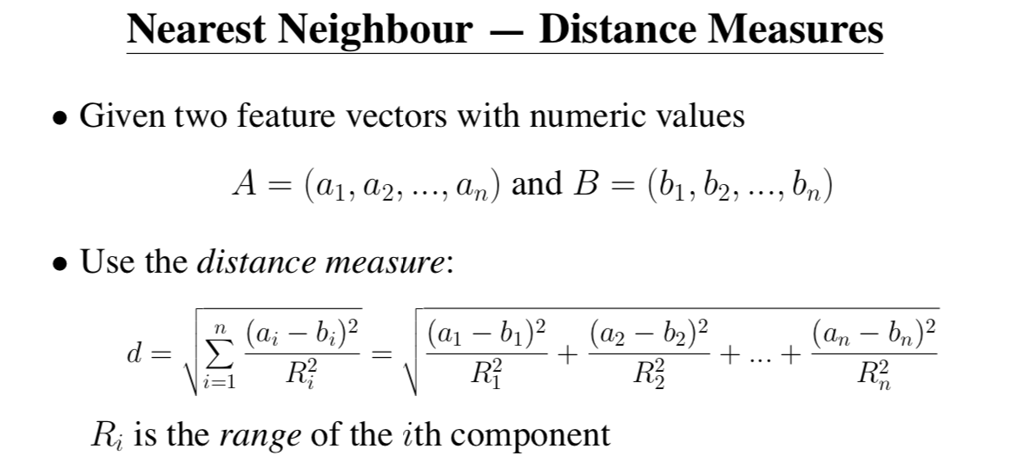
STEP 3 – Keras ResNet50
Base Layer
Connected Layer
Accuracy: 0.749
Pretrained ResNet50 model (50 layers deep) on ImageNet image database
Borrowing the base convolution network, we extracted image features for all article images (specific to the H&M image database)
Measured the Euclidean distance between the input image and the features of other articles generated by our model
Notes:
48 Convolution layers along with 1 MaxPool and 1 Average Pool layer.
Weights = ’imagenet’ – convoluted base weights, include_top = False – remove top fully connected layer

Slide 48
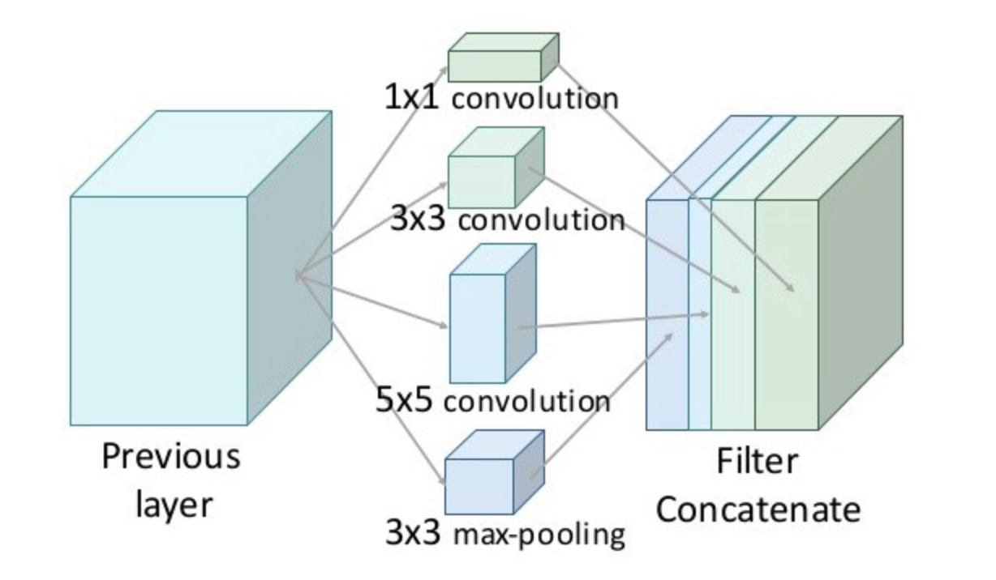
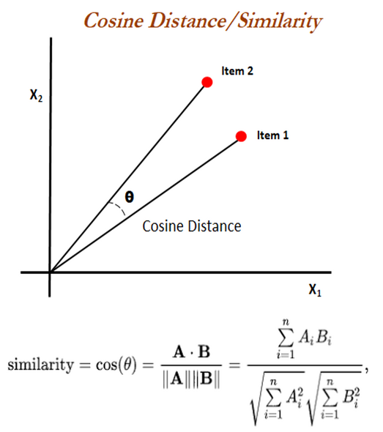
STEP 3 – Keras Xception
Accuracy: 0.790
Pretrained Xception model (88 layers deep) on ImageNet image database.
Measured the Cosine Similarity between the input image and the features of other articles generated by our model. A more accurate means of finding similarity as orientation is considered, on top of distance.

Slide 49
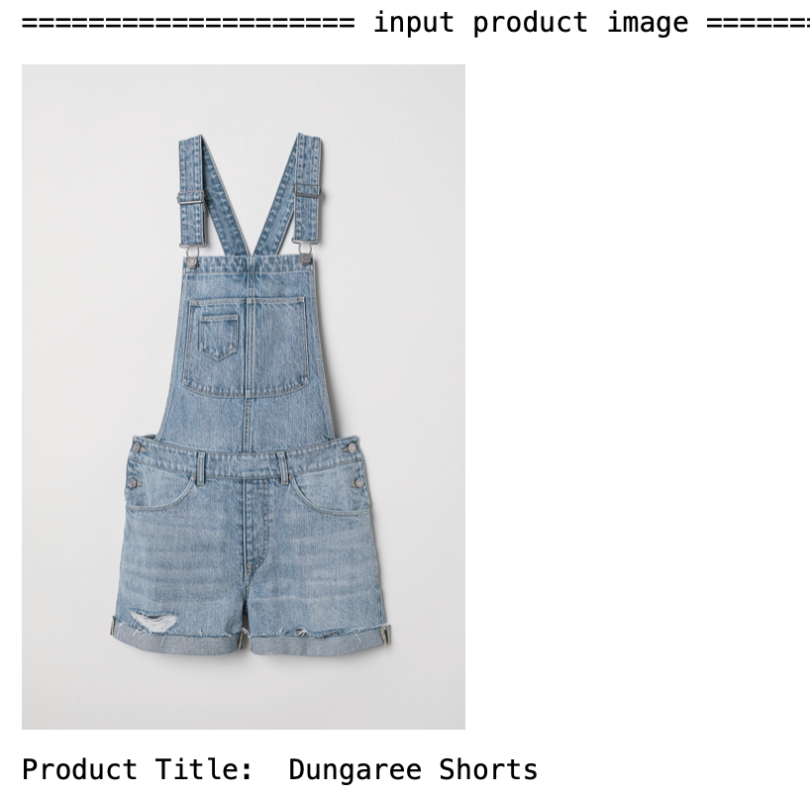
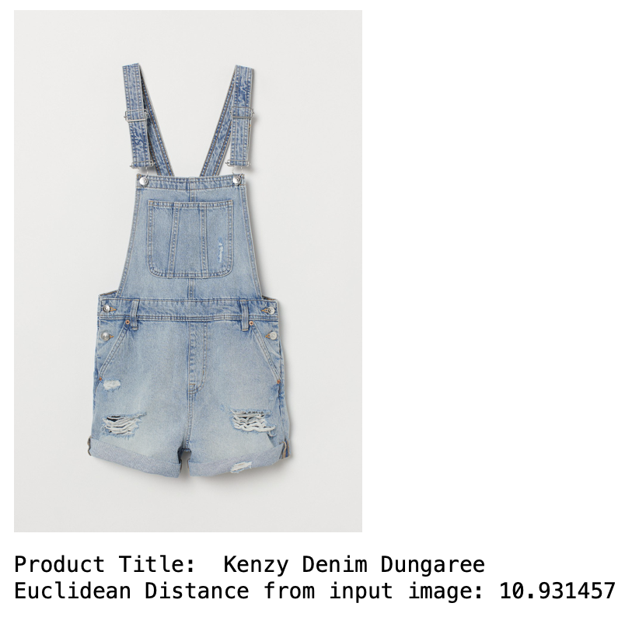
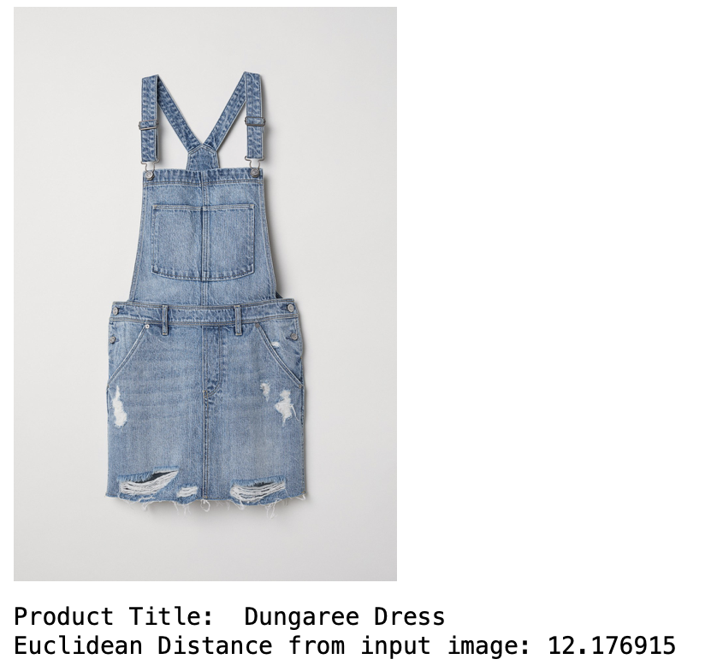
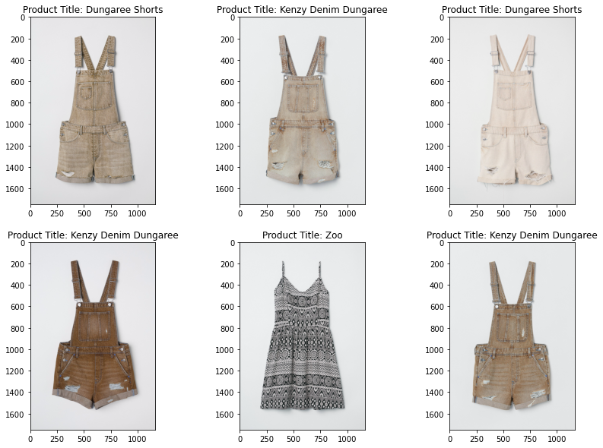
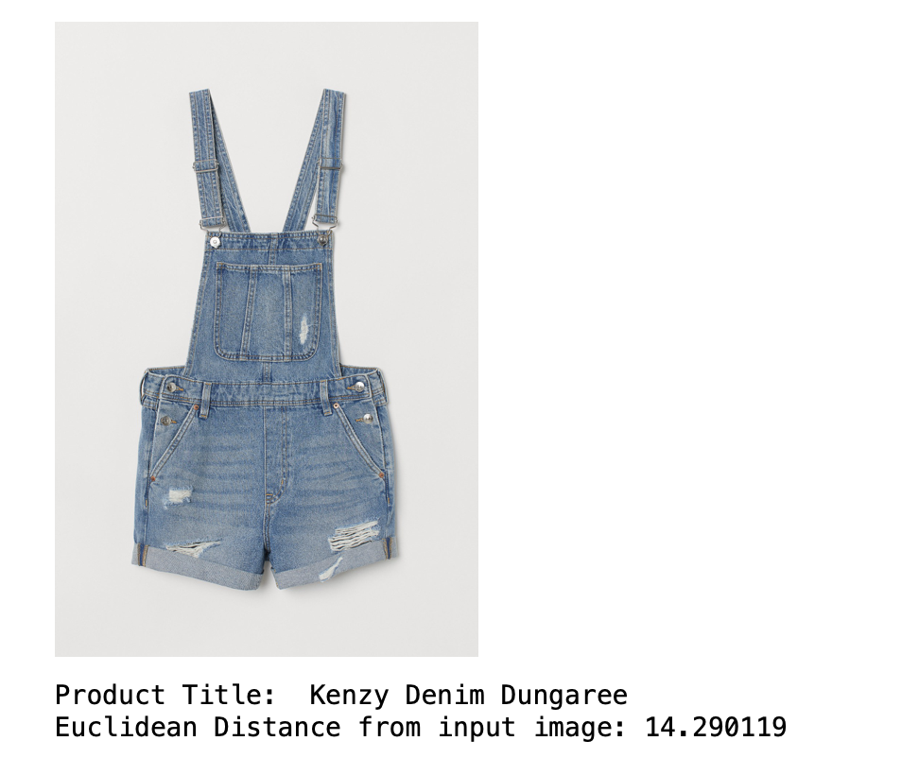

Comparisons between models
Xception with cosine similarity
ResNet50 with Euclidean distance

Slide 50


SUMMARY OF FINDINGS
05

Slide 51
CONCLUDING KEY INSIGHTS
Understanding the state of the business
The company targets young adults and older mature adults
Ladieswear and Teens product categories are their main revenue driver. Average sales transaction quantum is small
Revenue and purchase transactions trends are consistent and steady
Creating Value with Hybrid Recommender
We developed a full data pipeline to make use of the available dataset effectively and efficiently
Using hybrid filtering, we determine when a customer will make a purchase next and what they might purchase given their spending habits
Leveraging a deep learning network ResNet, we use CNN to train the model on product images and KNN for evaluating an article recommendation

Slide 52

FUTURE WORKS
06

Slide 53
FUTURE WORKS
Quality of available data is important. We look to source for more data points that will allow us to rely less on some of the assumptions that we have made thus far.
Estimating customer’s average spending amount based on transactional history
The nature of this problem is can be rather unpredictable. There are many factors that may sway a customer’s decision to spend more on an item that they like. What we have done so far is to make a fair estimate of the customer’s typical budget which will drive their decision to purchase an item of interest. We could use an AI model to learn the customers purchase habits and make better predictions.

Slide 54
FUTURE WORKS
Quality of training data is more important than data quantity.
Expanding final suggestion list with complementary items using AI
Improving image processing model through transfer learning. By integrating a custom connected layer, our image processing model could be significantly more accurate in extracting unique features of each clothing article.

Slide 55

THANKS!

